Slide 1
Project 3: SAP Prediction
By: Abdullah Tanveer, Hakeem Yatim, Mitsuki Shimonishi

Slide 2
Problem
We are looking at recovered IED data and we want to build a predictive model for whether a particle came from an exploded IED or unexploded IED and to interpret whether or not Dr. Hietpas’ suspicion is reasonable

Slide 3
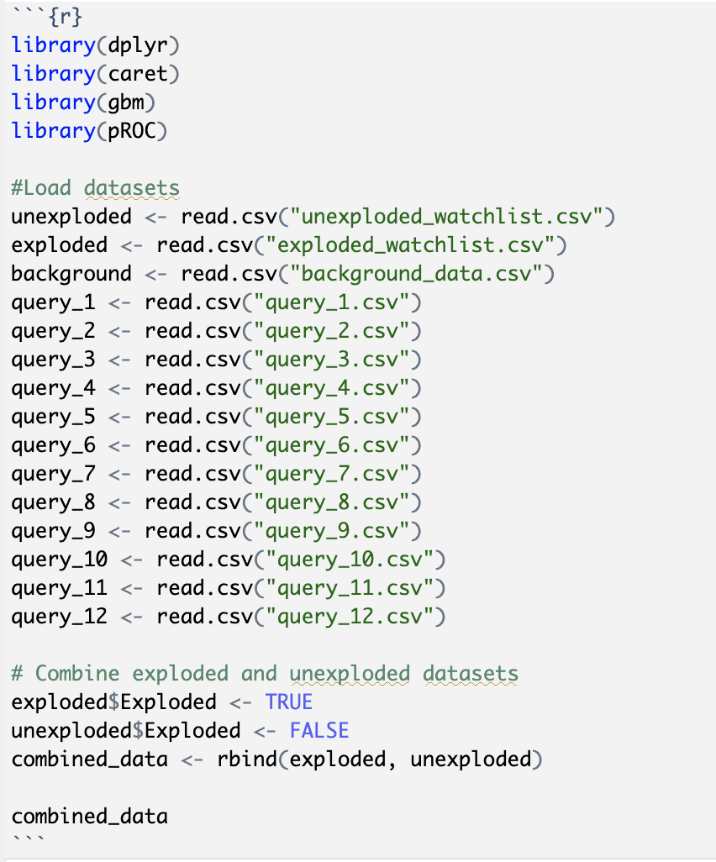
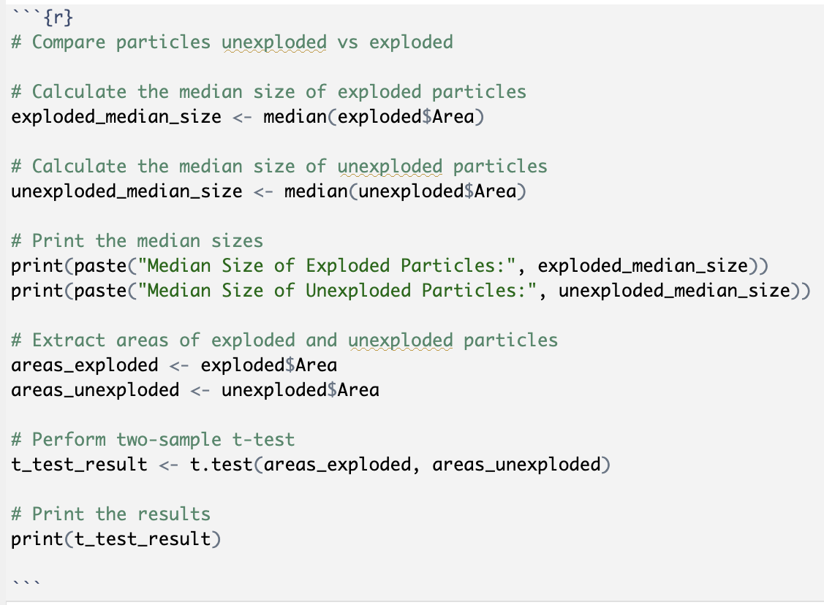
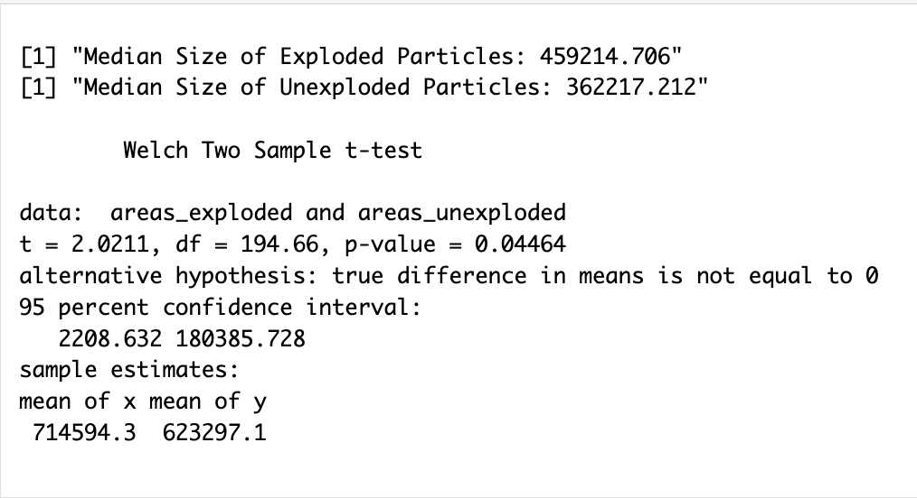
Data Selection
We loaded up the data and combined both unexploded and exploded data.
We decided to use the area as an indicator of particle sizes.
We looked at the median and mean of the areas to see the size difference between unexploded and exploded particles.
Unexploded particles are bigger than exploded particles.
keep in mind that we have way more data entries for unexploded particles than exploded particles.

Slide 4
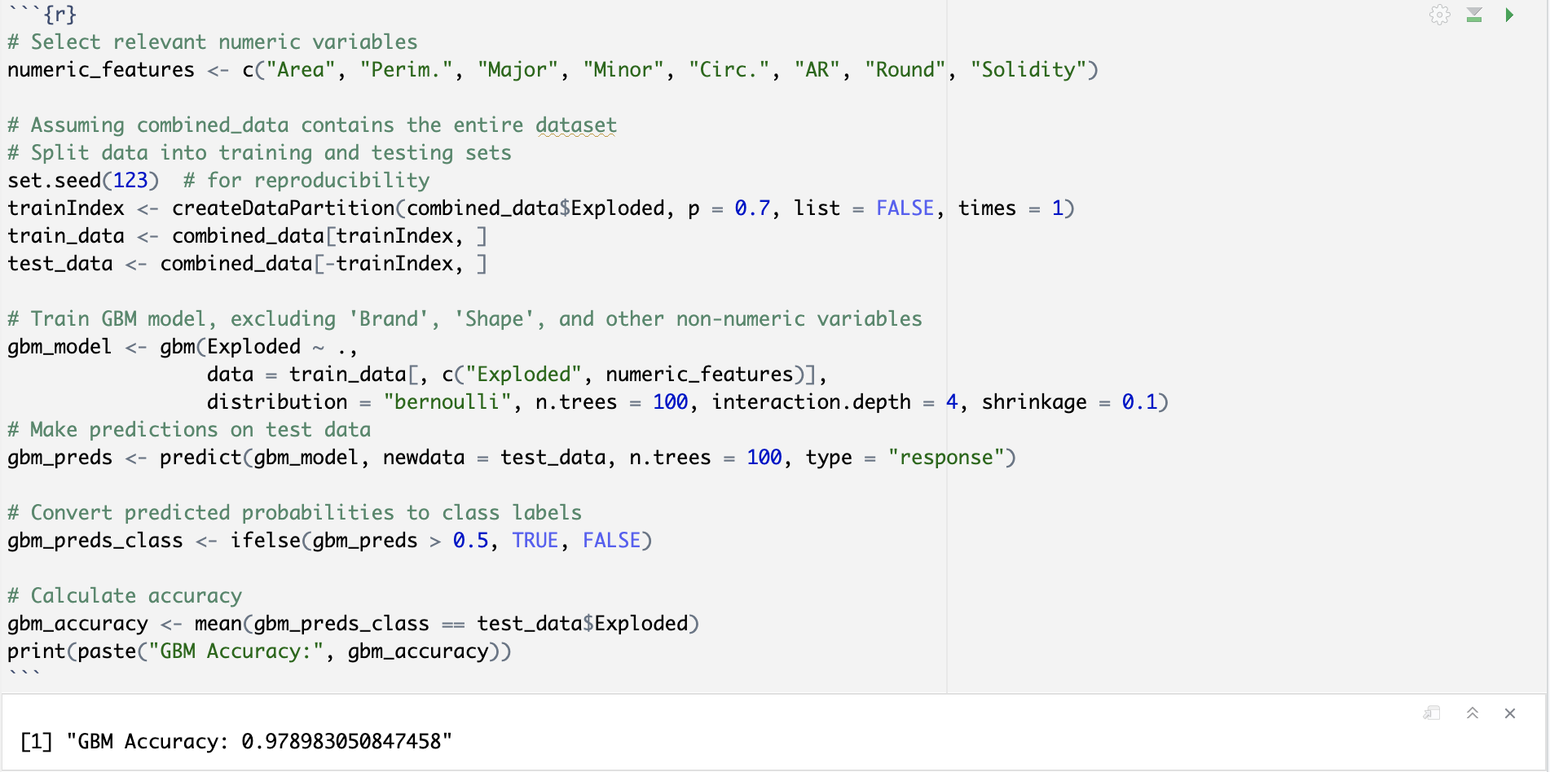
Model Building
We chose GBM because we are dealing with a binary classification problem and we have class imbalances due to having more data entries for the unexploded particles
Got a pretty high accuracy of 98%

Slide 5
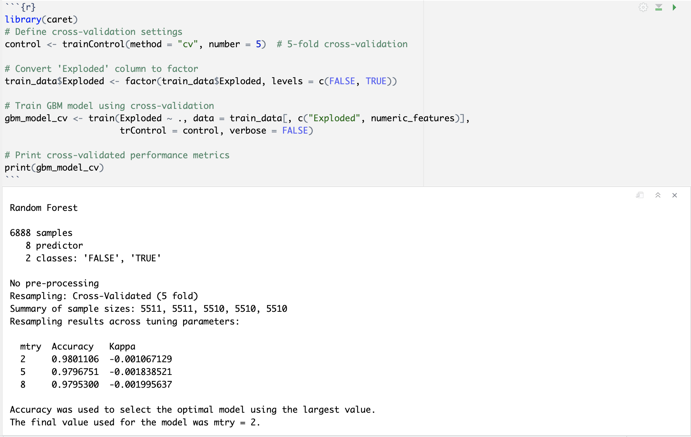
Cross Validation
We did k-cross validation after developing the model to see it’s performance.
Still got a high accuracy of around 98%

Slide 6
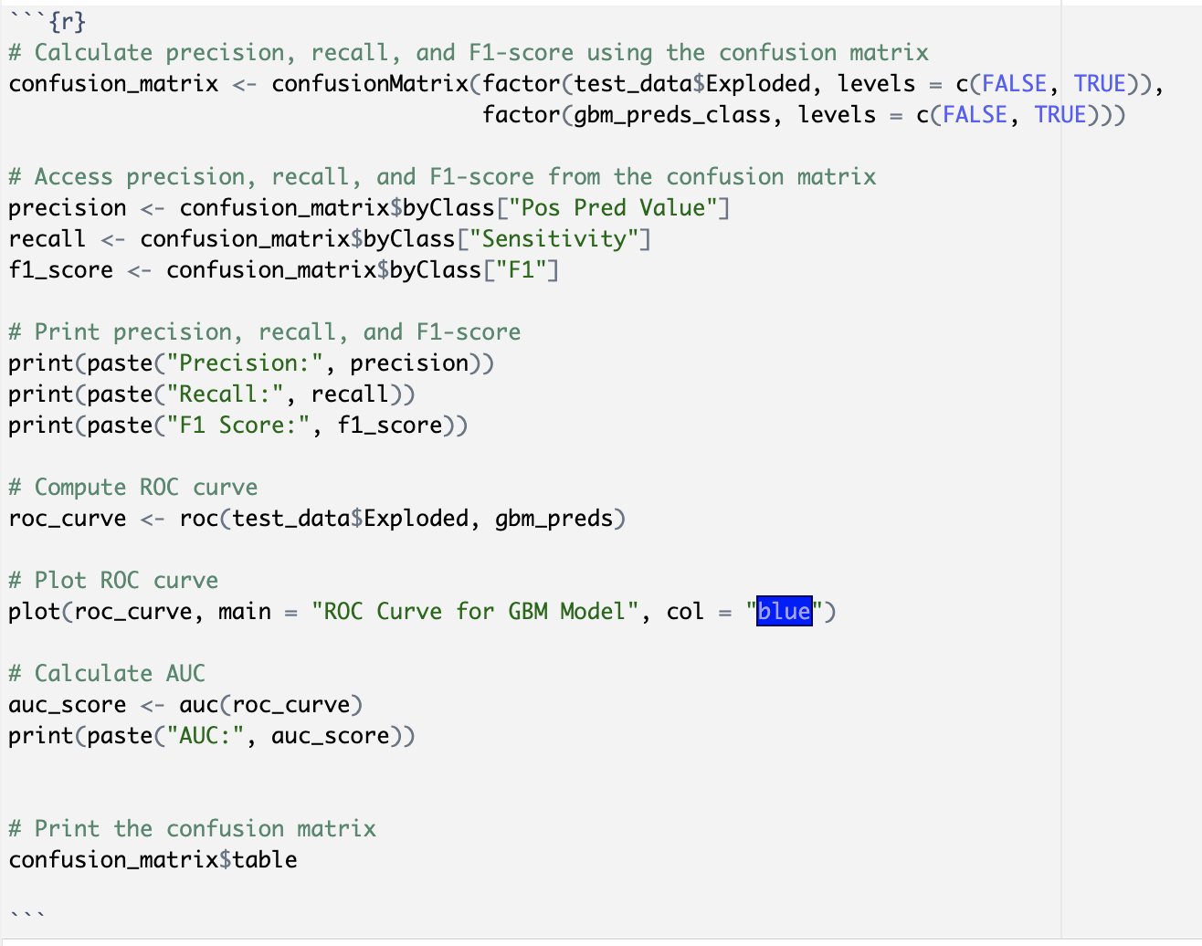
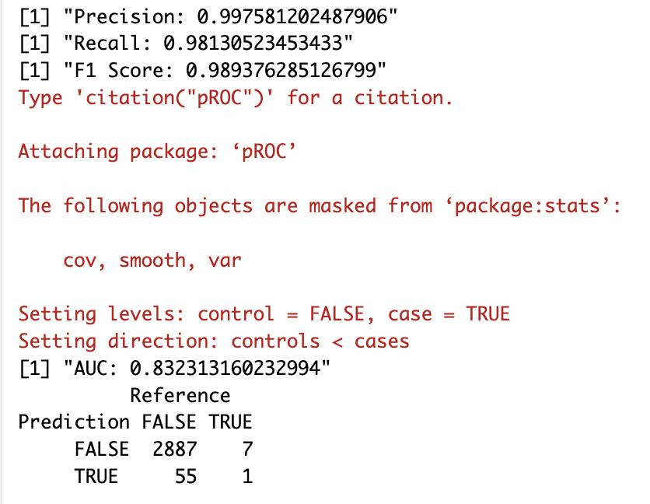
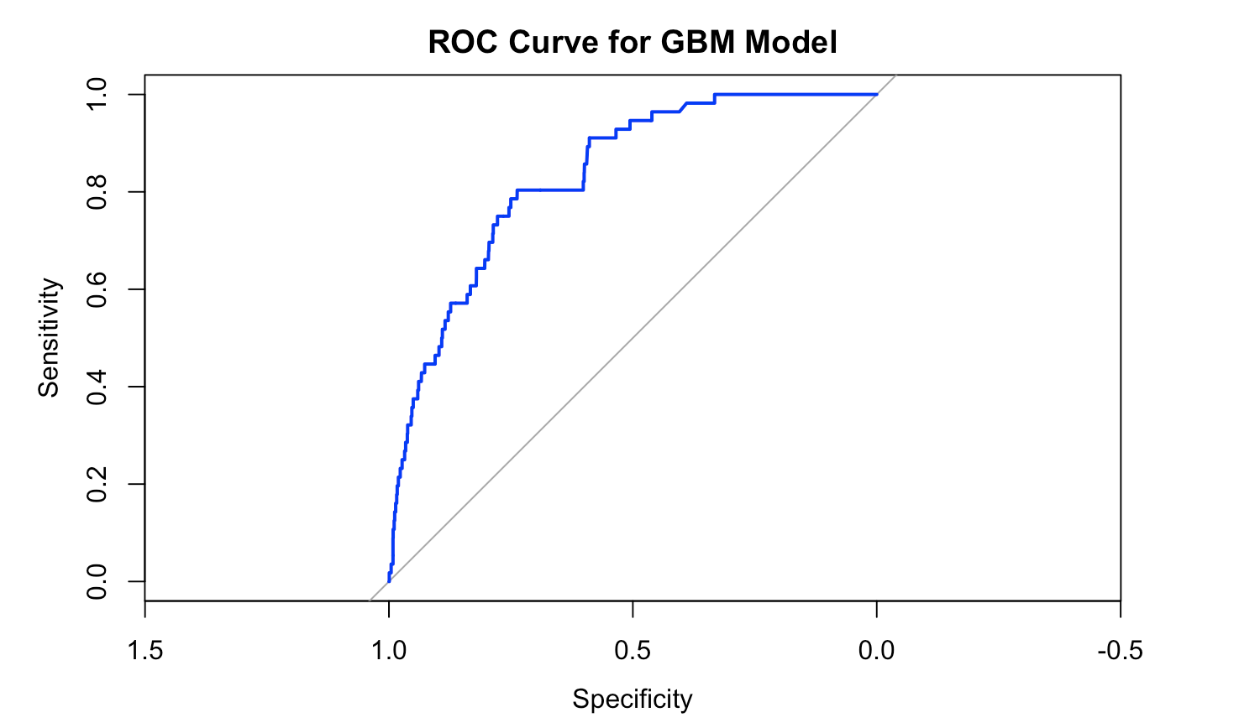
Model Evaluation
We looked at the confusion matrix, precision, recall, and f1 score to evaluate the model further since we have a high accuracy.
Precision, recall, and f1 scores are high
the model predicts particles that are truly exploded well while minimizing false positives (when model predicts unexploded when it’s truly exploded).
AUC score is also high which means that the model distinguishes unexploded vs exploded reasonably.
The confusion matrix, however, shows that the model predicts 1 exploded particle correctly and 2887 unexploded particle correctly.
We think that this is because of the data imbalance between the entries of exploded and unexploded particles.

Slide 7
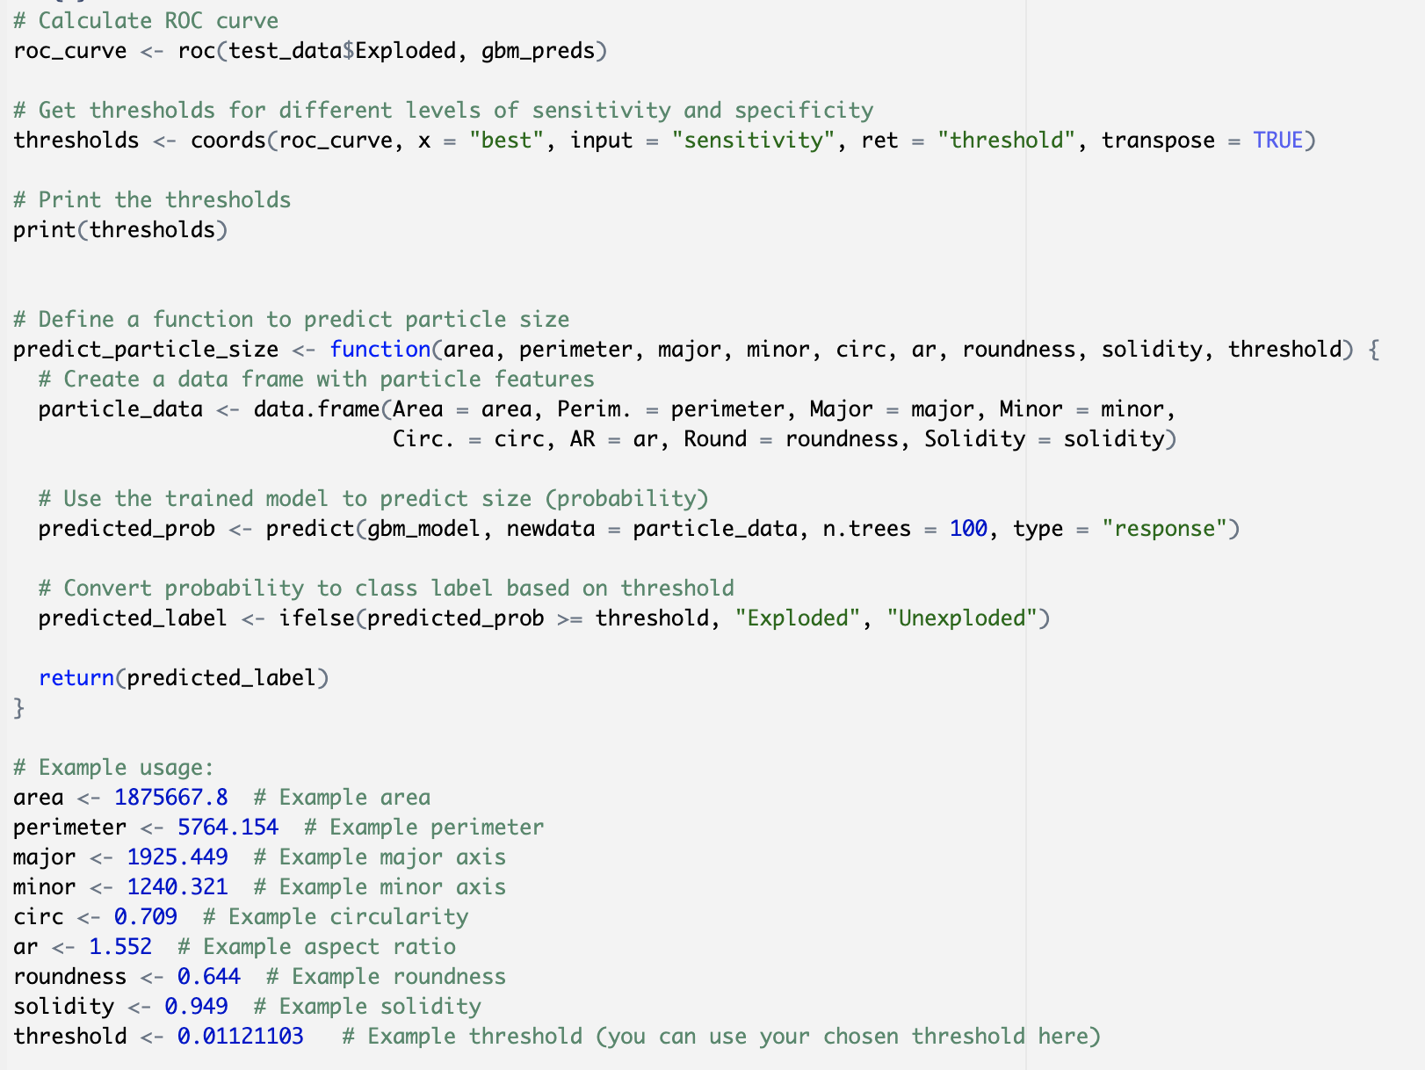
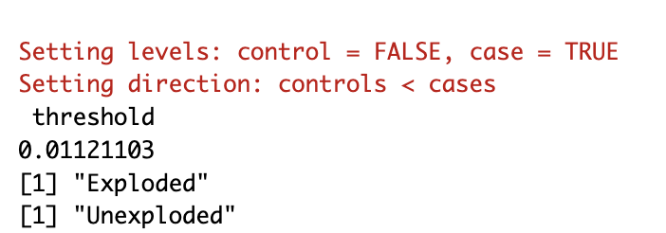
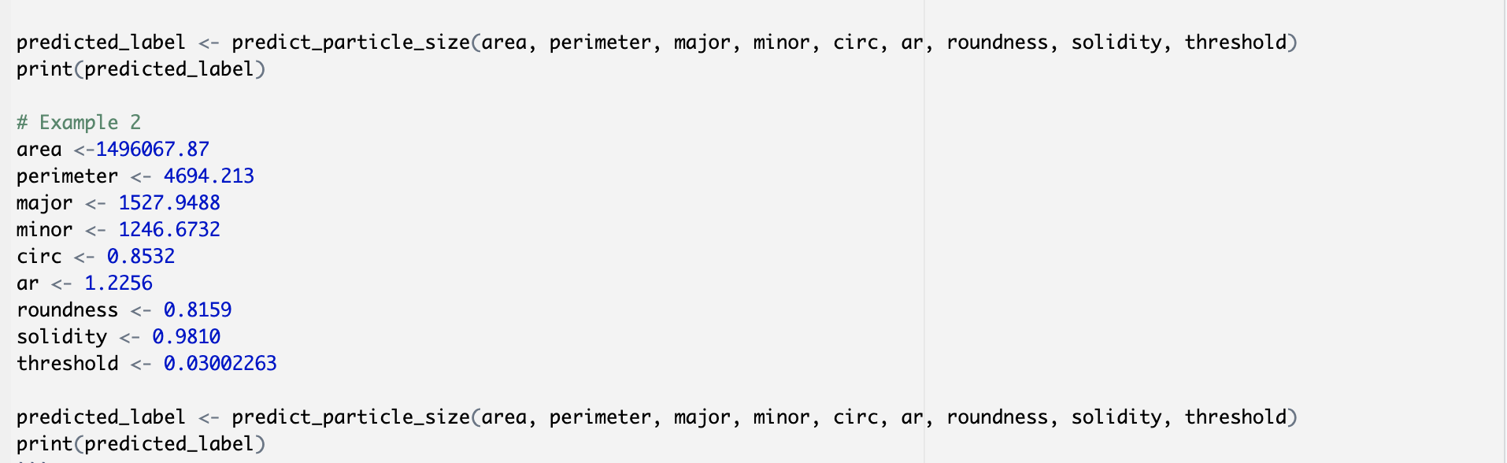
Function of the Size of the Particles
We got a reasonable threshold from the ROC curve
Developed the function using the GBM model we developed previously
Tried 2 different entries that we used from the actual data to see if the function predicted correctly

Slide 8
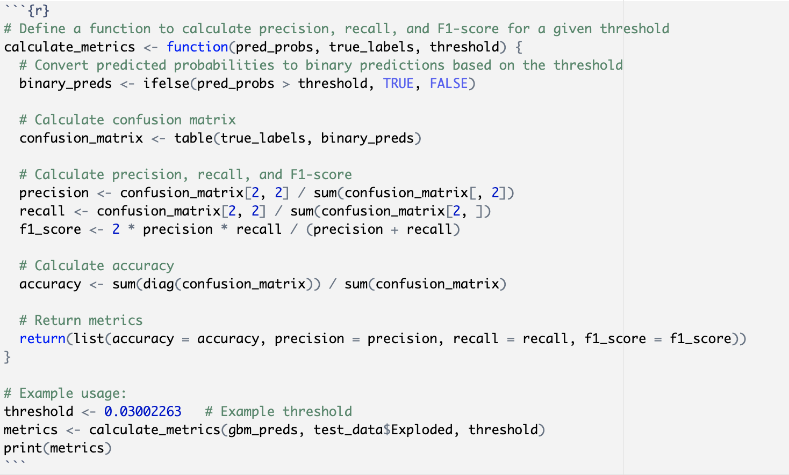
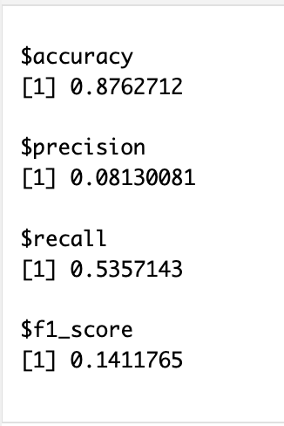
Function Evaluation
We looked at the Precision, Recall, and F1 scores of the function
We got a lower accuracy than the actual model, we got a low precision, recall, f1 score.
The low recall for the exploded particles means that the model may not effectively capture smaller particles from exploded IED’s, which aligns with Dr. Hietpas’ suspicion that post-blast recovered samples will tend to have fewer smaller particles.
The low recall also means that the smaller particle, which are more easily consumed in the blast, may not be represented well in the dataset or are more challenging for the model to classify accurately

Slide 9
Conclusion
We successfully built a model that predicts whether or not a particle is recovered from an exploded vs unexploded IED
Dr. Hietpas’ suspicion is correct. Through the model, we can say that the post-blast recovered sample will tend to have fewer smaller particles due to those particles being more easily consumed in the blast
Things to do differently:
Use a different feature than the area as the size indicator of the particles and may have different results from what we got.
we could also do undersampling of the unexploded data to have a better class balance. We tried it but we thought it might not capture the unexploded data as accurately.

Slide 10
References
https://towardsdatascience.com/understanding-gradient-boosting-machines-9be756fe76ab
Dr. Saunders’ Lectures
https://chat.openai.com
https://stats.stackexchange.com/questions/52239/how-does-cross-validation-work-in-rs-gbm-package
https://www.sciencedirect.com/science/article/abs/pii/S0379073823003304?via%3Dihub
https://www.rdocumentation.org/packages/stats/versions/3.6.2/topics/t.test
https://towardsdatascience.com/a-look-at-precision-recall-and-f1-score-36b5fd0dd3ec
https://mlu-explain.github.io/roc-auc/

